Slide 1

Warehouse Stock Management

Slide 2
Problem Statement
An FMCG company entered into the instant noodles business two years back.
Their higher management has noticed that there is a miss match in the demand and supply. Where the demand is high, supply is pretty low and where the demand is low, supply is pretty high.
In both ways, it is an inventory cost loss to the company; hence, the higher management wants to optimize the supply quantity in every warehouse in the entire country.
Objective
Build a model, using historical data that will determine the optimum weight of the product to be shipped each time to the warehouse.​
Analyze the demand pattern in different pockets of the country so management can drive the advertisement campaign, particularly in those pockets.

Slide 3
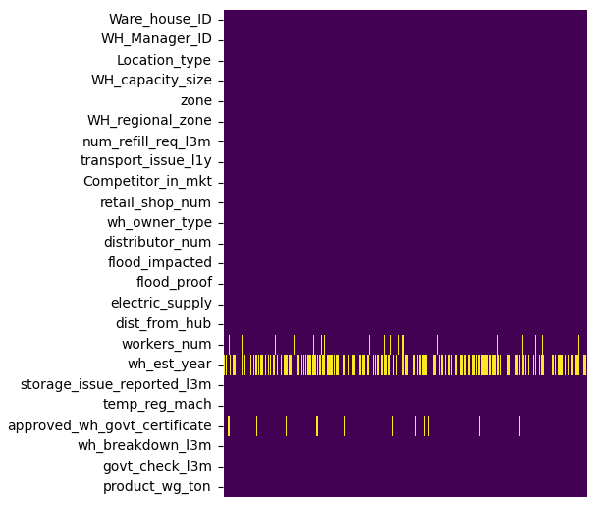
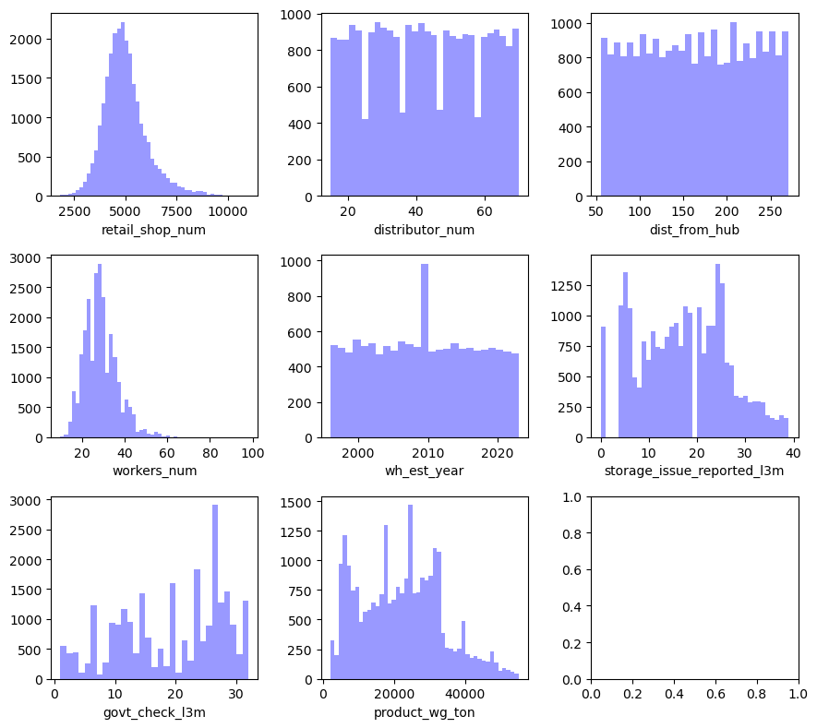
About the Dataset
25K
23
07
14
02
Number of observations
Number of features
Numerical features
Categorical features
Cardinal features
Missing Values
Distribution of numerical features
~47.5% values are missing in "wh_est_year" column.
~ 4% values are missing in 'workers_num' & 'approved_wh_govt_certificate' columns.
Features 'wh_est_year','dist_from_hub' are uniformly distributed.
Features 'retail_shop_num','workers_num' are fairly normally distributed.

Slide 4
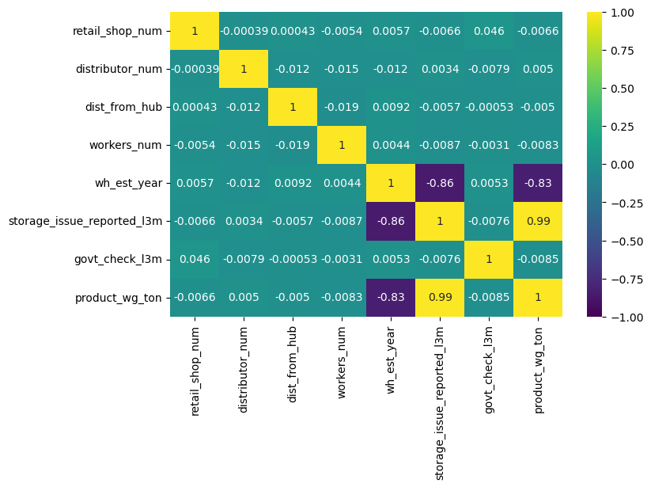
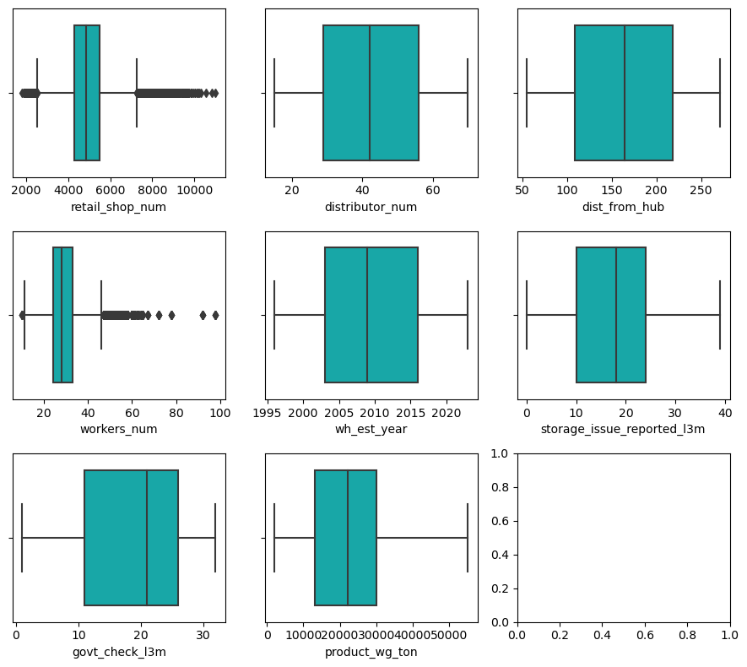
About the Dataset
Outliers
Correlation
'retail_shop_num' column has ~ 4% outliers
'workers_num' column has ~ 2.5% outliers
Feature 'storage_issue_reported_l3m' has strong positive correlation with dependent feature 'product_wg_ton'
Feature wh_est_year' has negative correlation with the dependent feature.
This indicates large volumes of product have been shipped to older warehouses in the last 3 months compared to newer ones.

Slide 5
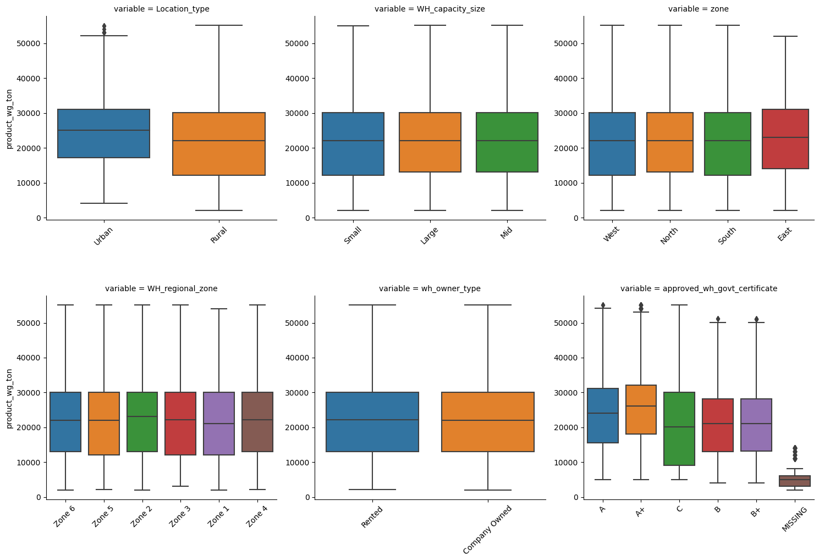
About the Dataset
Categorical features
The median weight of product shipped to Urban warehouses is higher by 13.6 % compared to Rural warehouses
Median product weight shipped to Small/Mid/Large warehouses is nearly same.
This indicates warehouse capacity size does not have any impact on the weight of product shipped.
High amount of product is shipped to Eastern zone compared to other zones
Highest product weight is shipped in Zone 2 (23K tons ) followed by Zone 4,3,6,5 (~22K tons).
Least product is shipped to Zone 1 (~21K tons)
Equal amounts of product weight is shipped to both Rented & Company Owned warehouses.
The amount of product weight shipped to a warehouse increases with a better government certification.

Slide 6
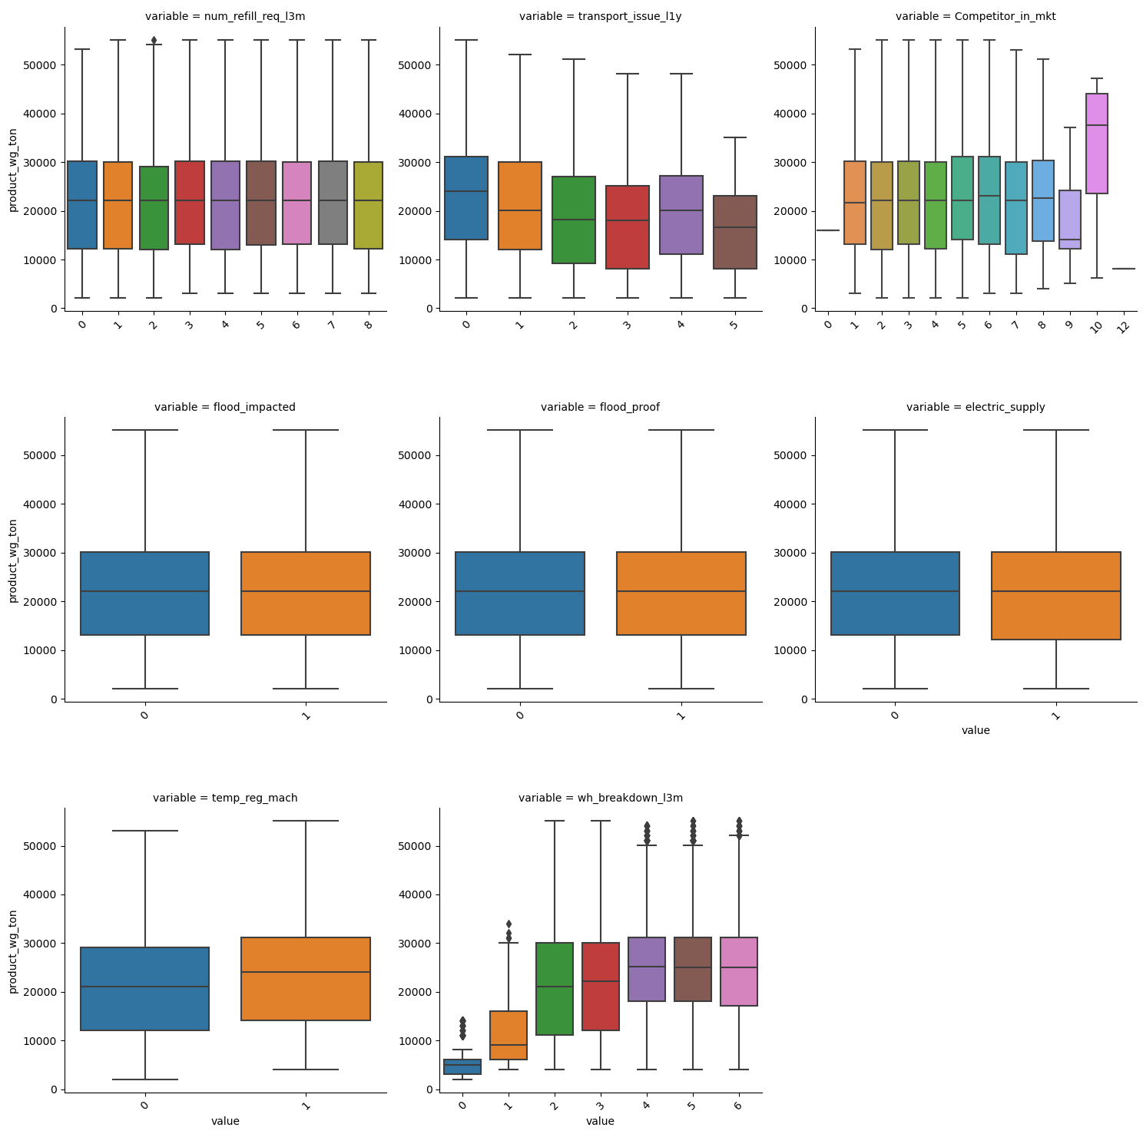
About the Dataset
Categorical features
The product shipped to warehouse decreases as the number of transport issues rise.
More product is shipped to the warehouse if it has temperature indicator.
More product is shipped to the warehouse if it has faced breakdown in the last 3 months.
The product shipped remains constant above 3 breakdowns.
Product weight shipped remains consistent even when warehouse is flood impacted/flood proof/has electric supply or not.
Product weight is generally seen to be consistent irrespective of number of competitors in the market, with some exceptions.

Slide 7
Data Preprocessing
Feature Engineering
Train-Test split
Missing values
Outliers
Feature Encoding
Feature Scaling
Dropped features 'WH_Manager_ID','Ware_house_ID' due to high cardinality
New feature created 'num_competitors'
0-2
3-5
More than 5
New feature created 'wh_age'
Very Old - Established year 2000 & below
Old - Established year between 2001 & 2010 (both included)
New - Established year between 2011 & 2020 (both included)
Recent - Established year 2021 and above.
Split the dataset into train-test set
Reserved 20% data for test set
Train size = 20K observations
Test size = 5K observations
workers_num -
The distribution of 'workers_num' column is fairly normal,therefore filling with mean values
approved_wh_govt_certificate -
Imputing missing values with mode
wh_age -
More than 45% values are missing, therefore creating an additional category - 'missing'
Applied log-transform
retail_shop_num
workers_num
Encoded ordinal features with “Ordinal Encoder”
WH_capacity_size
approved_wh_govt_certificate
wh_age
Encoded nominal features using “Dummy encoder.”
Location_type
Zone
WH_regional_zone
wh_owner_type
num_competitors
Features scaled down using “Standard Scaler”

Slide 8
Model results
Model | R2_score | Mean Absolute error
Linear Regression | 0.9777 | 1281.111
Stochastic Gradient Descent | 0.9775 | 1297.884
Lasso Regression | 0.9777 | 1280.227
Random Forest Regressor | 0.9938 | 670.126

